Slide 1
Big Mountain Ski Resort
By: Abhik Giri

Slide 2
Problem Identification
What types of changes should Big Mountain Resort make to select a better value for their ticket prices so that their revenue increases by 10% within a year?
Come up with a pricing model for ski resort tickets in Big Mountain’s market segment.
This project aims to build a predictive model for ticket price based on a number of facilities, or properties, boasted by resorts.
This model will be used to provide guidance for Big Mountain's pricing and future facility investment plans.

Slide 3
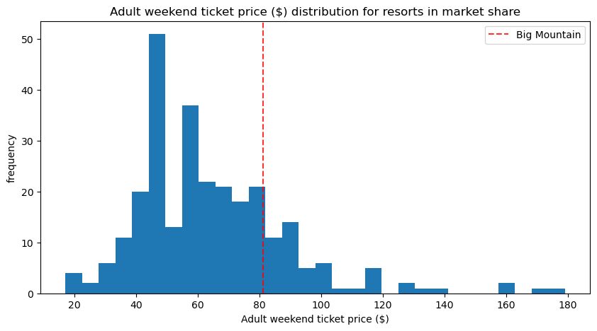
Recommendation and Key Findings
Currently, Big Mountain charges $81 per ticket.
According to the model the suggested ticket price should be $95.
Based on features that affect ticket prices the most Big Mountain is near the top compared to other ski resorts, while their ticket price is not near the top compared to other ski resorts.

Slide 4
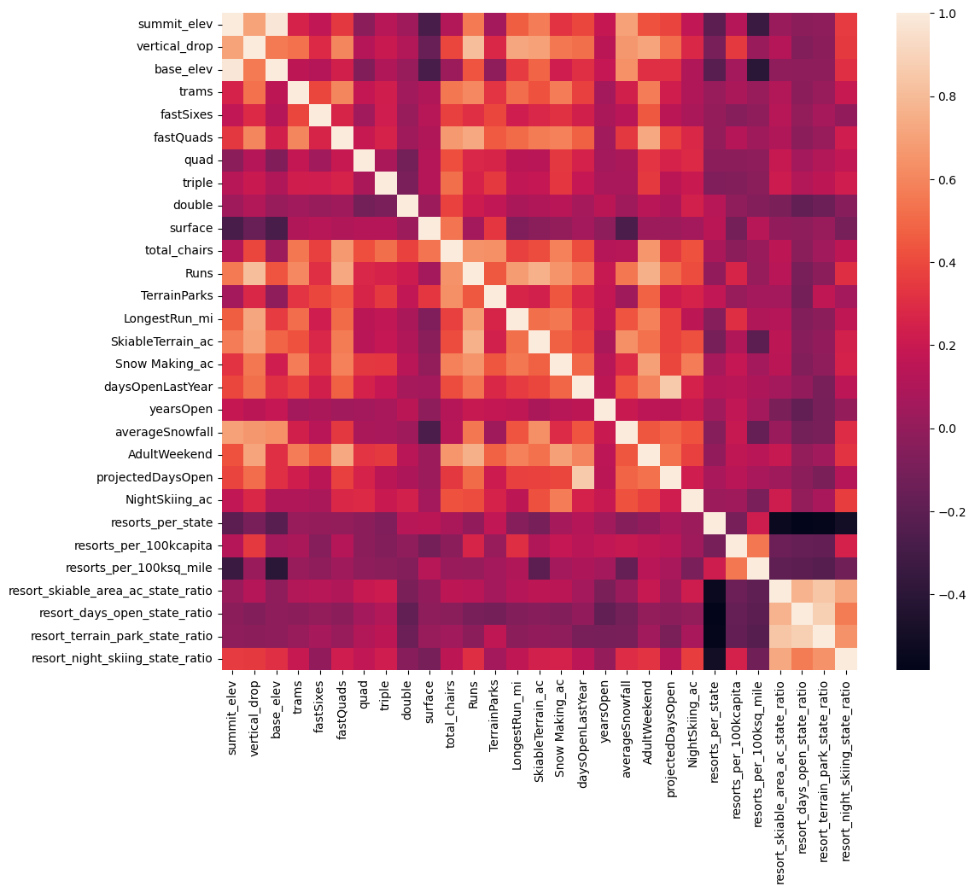
Exploratory Data Analysis
Cleaned up our data set by dropping columns, like number of fast eight chairs and adult weekday ticket prices.
While looking at other data, like state population and state sq. miles, we did not find any patterns, so we treated each state as the same.
The features that had the highest correlation with adult weekend ticket prices were:
Number of fast four chairs
Number of runs
Total area covered by snow making machines
Total number of chair lifts
Vertical change in elevation from summit to base

Slide 5
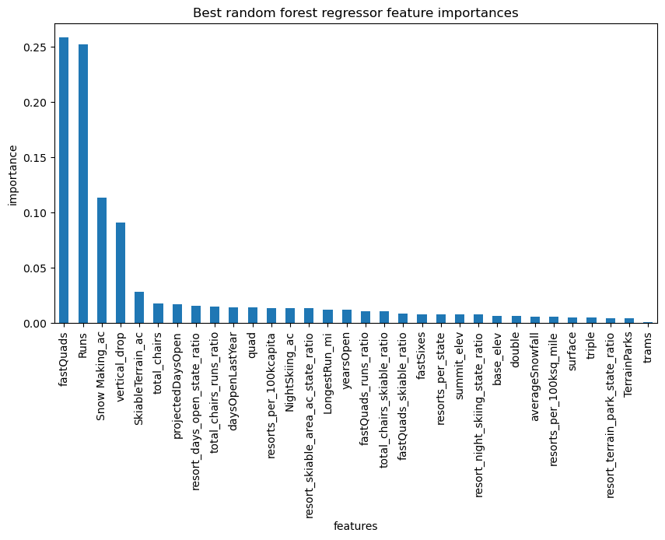
Random Forest Model
Out of the two models tested, the Random Forest Model has a lower cross-validation mean absolute error by almost $1. It also exhibits less variability. Verifying performance on the test set produces performance consistent with the cross-validation results.
Using the Random Forest Model and found that the top 4 features using this model are:
Number of fast four person chairs
Number of runs
Total area covered by snow making machines
Vertical change in elevation from summit to base
The estimated performance via cross validation for random forest was found to be %9.6 for the mean absolute error which is consistent with the test set.

Slide 6
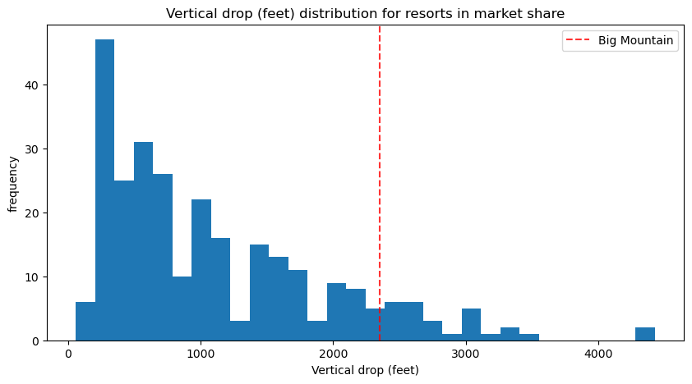
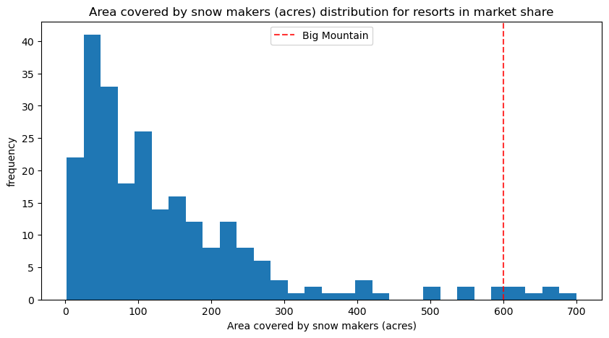
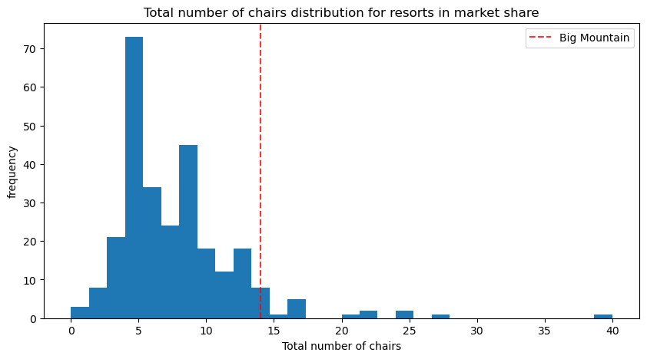
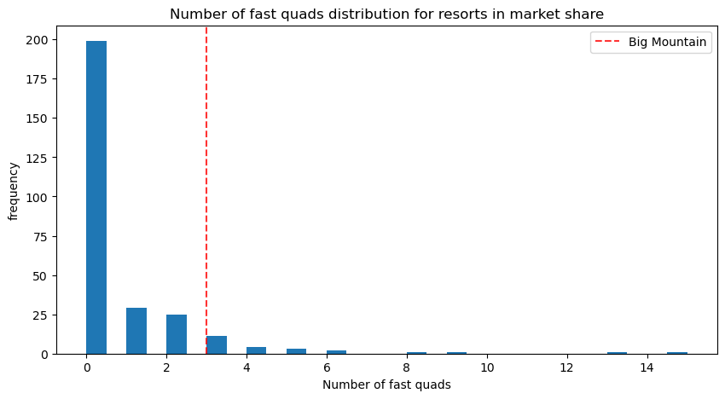
Big Mountain’s Features Compared to Other Ski Resorts
In all of the top 4 features that predict ticket prices, Big Mountain is near the top compared to other ski resorts, while their ticket price is not near the top compared to other ski resorts

Slide 7
Summary and Conclusion
Big Mountain Ski Resort should increase their ticket prices by at least 10%.
This is supported by the fact that based on the features Big Mountain has it is not maximizing its returns relative to its position in the market.
If we could get more information on what the overall maintenance costs are and what the payroll costs are for every ski resort, we could be better able to predict ticket prices.

